Slide 1

Kirjsten Blodgett
IDIOM Tremor Tracking Program

Slide 2
Background
__ wears a monitoring device.
This device records date, time, heart-rate, and movement.
Using the Actilife program, we are able to read multiple days worth of data.
The ActiLife program doesn't calculate her tremors.

Slide 3
Importance
The program I have created is important because it can take the ActiLife data and process it into information that is useful.
It gives information that would otherwise be over looked.
This information could make it easier to see improvements and help pin-point treatments.

Slide 4
Importance
This program could also help other patients with a similar condition as __.
This program is capable of targeting the tremor, recording the time, date, length and other information regarding the tremor.
This program reads the data, categorizes the data, and presents organized information.

Slide 5
Program
The program is able to pin-point tremors and display that information to the user in multiple ways.
It informs the user of how many tremors are on the file, the overall statistics concerning those tremors, and other features as well.
Two of the most useful features being sort and save.

Slide 6
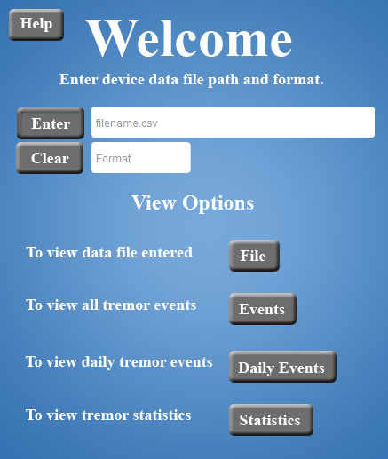
Program
The program prompts the user and presents the information in a way that is pleasant to the eye.

Slide 7
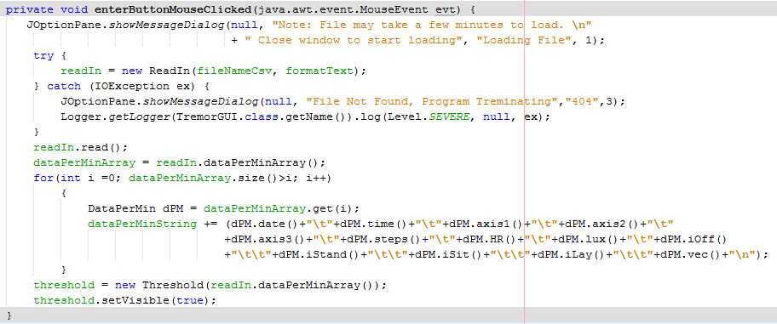
Code Explanation

Slide 8
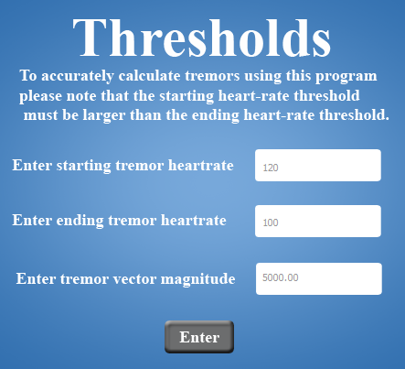
Code Explanation
When the user clicks the enter button, the program uses the numbers entered to calculate the tremors in the file.

Slide 9
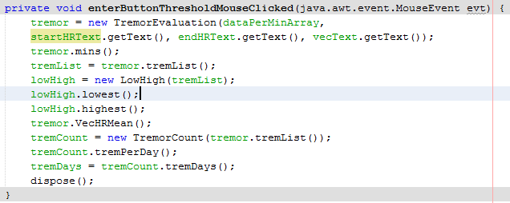
Code Explanation

Slide 10
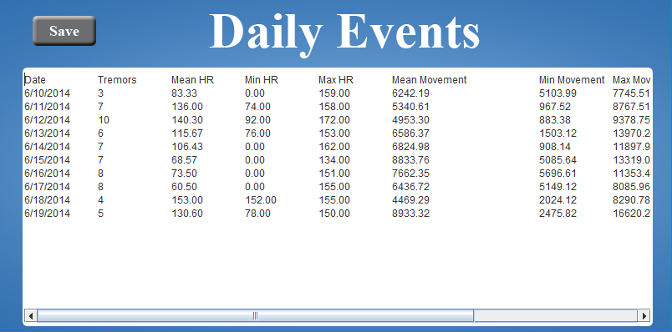
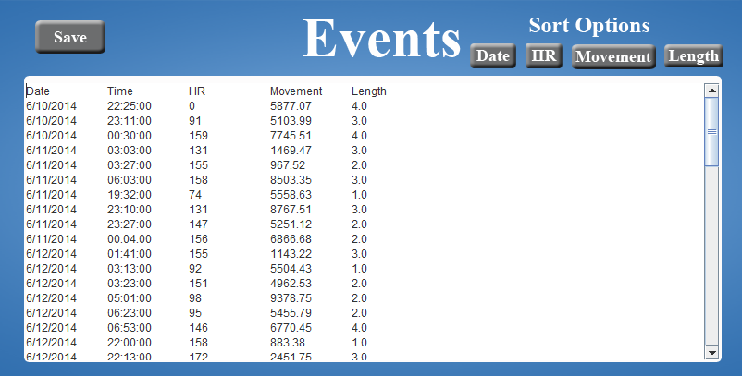
Example Output
Daily Events

Slide 11
Conclusion
By creating this tool, I have accomplished a way to analyze tremor data.
I learned how to build a user friendly tool, the software development life cycle, testing techniques (unit testing), and version control (git).

Slide 12



Special Thanks
Galina Erikson
Dr. Ali Torkamani
Jonathan Zhu
Scripps Translational Science Research Institute

